Slide 1
Software Engineering
Chapter 4 Requirements

Slide 2
Presentation Outline
What is Requirement?
Software Requirements
Sources of Requirement
The Goal of Software Development
Types of Software Requirements

Slide 3
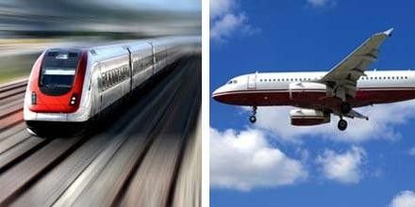
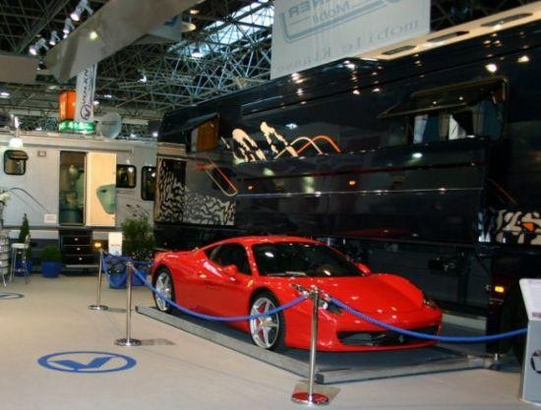
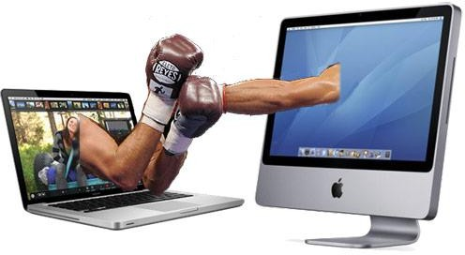
Requirement
Something required, something wanted or needed
  Webster’s dictionary
There is a huge difference between wanted and needed and it should be kept in mind all the time
Need- something you have to have
Want -something you would like to have

Slide 4


Software Requirements
A complete description of what the software system will do without describing
how it will do it is represented by the software requirements
Software requirements are complete specification of the desired external
behavior of the software system to be built
Response of software against the input

Slide 5
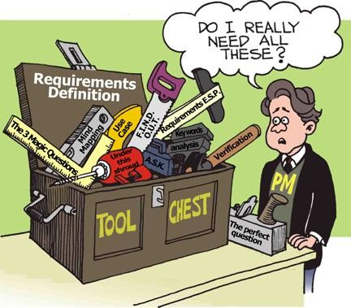
Requirement
Can be constraint
Functionality
A condition or capability that must be met or possessed by a system...to satisfy a contract, standard, specification, or other formally imposed document
▫ IEEE Std 729

Slide 6
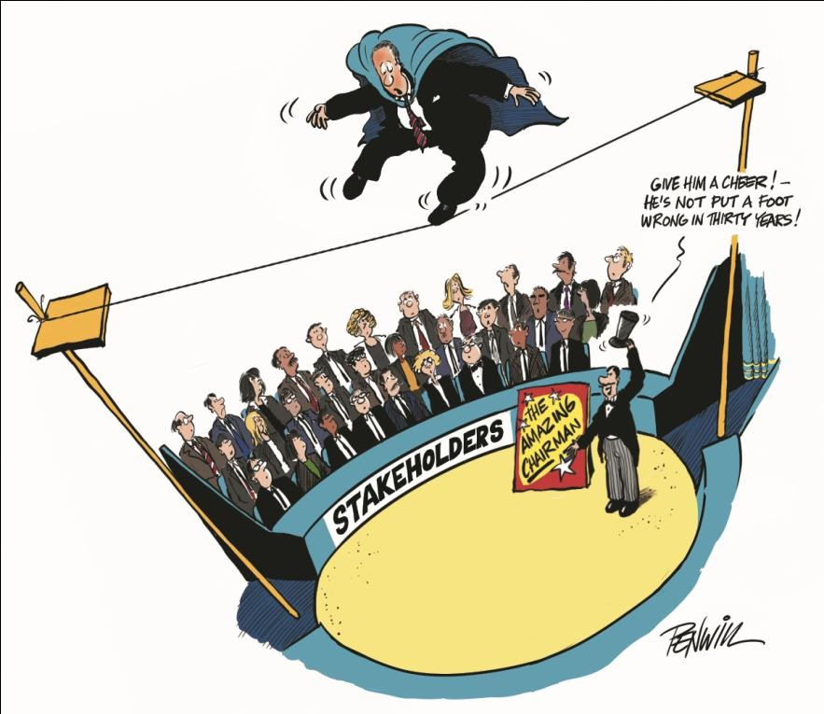


Sources of Requirement
Stakeholders
Documents

Slide 7

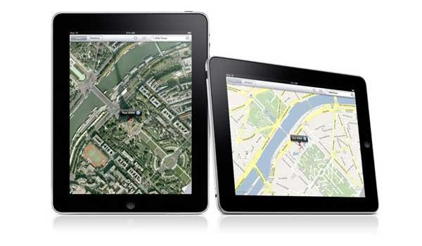
Sources of Requirement
Existing system
Domain

Slide 8
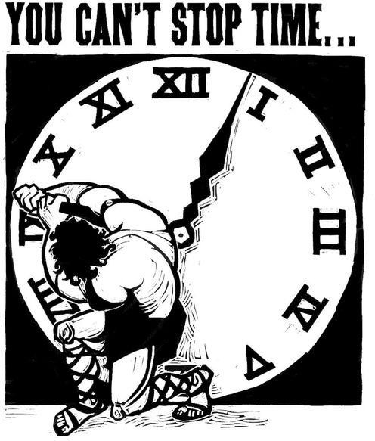
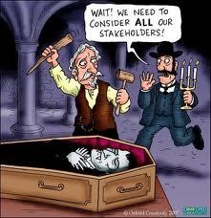
The Goal of Software Development[1]
The goal of software development is to develop quality software on time and on budget that meets customers' real needs.
A software is good if its meets STAKEHOLDER Expectation:
  it is (at least) correct, reliable, maintainable,
user-friendly …
  the total cost it incurs over all phases of its
life cycle is minimal and within the budget

Slide 9
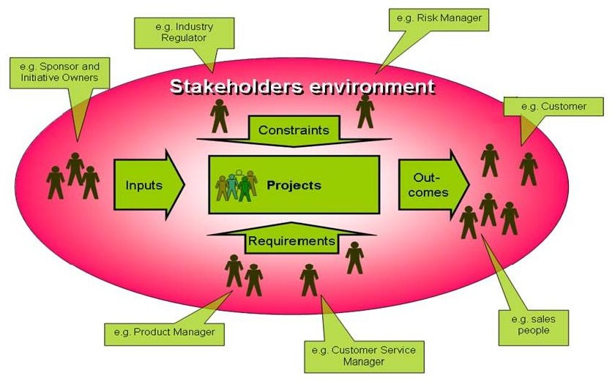
Context: Stakeholder's Environment

Slide 10
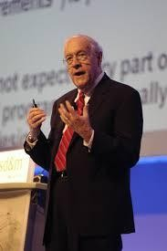
Importance of Software Requirements
The hardest single part of building a software system is deciding what to build. No other part of the work so cripples the resulting system if done wrong. (Fred Brooks)

Slide 11
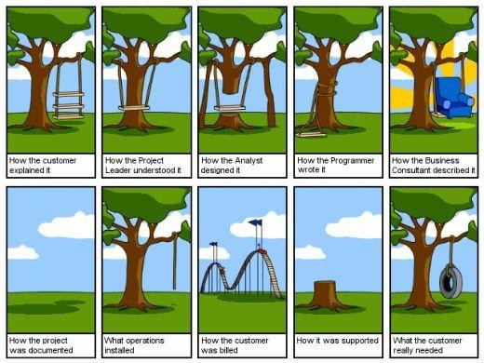
The Root Causes of Project Success and Failure

Slide 12
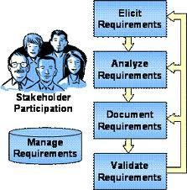
Requirements Engineering Process
Elicitation: work with the customer on
gathering requirements
Analysis: process this information to
understand it, classify in various
categories, and relate
the
possible
customer needs to
software requirements
Specification: Structure the customer input and derived requirements as written documents and diagrams
Validation: you’ll ask your customer to confirm that what you’ve written is accurate and complete and to correct errors.

Slide 13
Types of requirement

Slide 14
Types of requirement
User requirements
▫ High-level statements (in natural language or simple diagrams) that describe what services the system should provide and the constraints under which it operates, from the perspective of the end-users or customers.
Example (Banking App):
  “The system shall allow users to check their account balance through a mobile app.”
  “The system shall allow customers to transfer money between accounts.”

Slide 15
Types of requirement
System requirements
Detailed descriptions of the system’s functions, services, and constraints. These define what should be implemented and are written for developers, testers, and designers.
Example (Banking App):
“The system shall encrypt all user data using AES-256 encryption.”

Slide 16
Example
User Requirement:
“The user shall be able to purchase products online.”
System Requirements:
1. The system shall allow users to add items to a shopping cart.
2. The system shall allow users to checkout using credit card, debit card, or mobile wallet.
3. The system shall send a confirmation email and SMS after purchase.
4. The system shall update the product inventory database in real-time.
1 user requirement expanded into 4 system requirements.

Slide 17
Example
User Requirements:
“The user shall log in using email.”
“The user shall log in using username.”
“The user shall log in using mobile number.”
System Requirement:
“The system shall authenticate users via email, username, or mobile number using the same login service.”

Slide 18
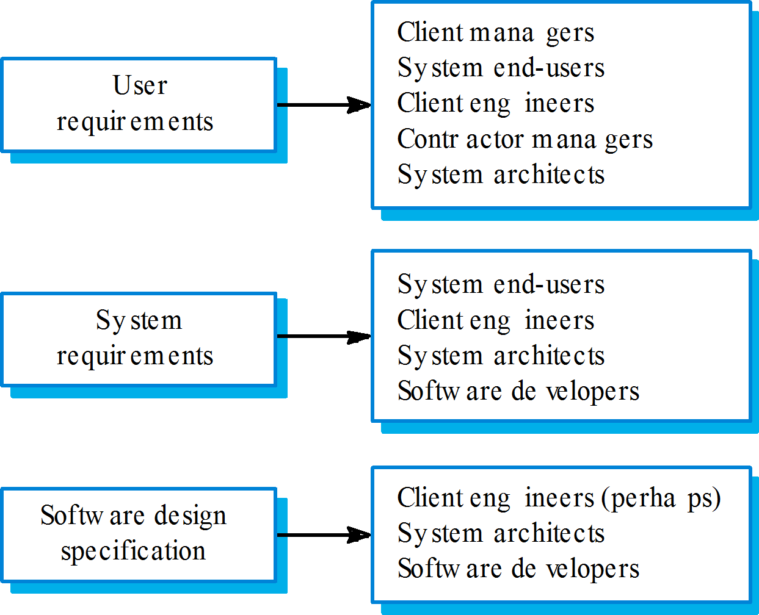
Requirements readers

Slide 19
Functional and non-functional requirements
Functional requirements
▫ Define what the system should do (the actual functions, services, features).
Usually linked to user goals.
Non-functional requirements
▫ Define how the system should behave (quality attributes).
Domain requirements
▫ Requirements that come from the application domain of the system and that reflect characteristics of that domain.

Slide 20
Domain requirements
Derived from the application domain and describe system characteristics and features that reflect the domain.
Domain requirements be new functional requirements, constraints on existing requirements or define specific computations.
If domain requirements are not satisfied, the system may be unworkable.

Slide 21
Library system domain requirements
There shall be a standard user databases which shall be based standard.
interface to all on the Z39.50
Because of copyright restrictions, some documents must be deleted immediately on arrival. Depending on the user’s requirements, these documents will either be printed locally on the system server for manually forwarding to the user or routed to a network printer.

Slide 22
Domain requirements problems
Understandability
▫ Requirements are expressed in the language of the application domain;
▫ This is often not understood by software engineers developing the system.

Slide 23
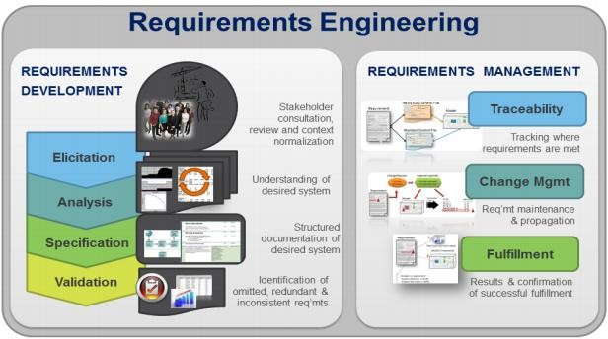
Requirements Management
Requirements management is the process of documenting,
analyzing, tracing, prioritizing and agreeing on requirements
and then controlling change
and communicating to relevant
stakeholders.

Slide 24
Functional requirements
Describe functionality or system services.
Depend on the type of software, expected users and the type of system where the software is used.
Functional user requirements is high-level statements of what the system should do but functional system requirements should describe the system services in detail.

Slide 25
The LIBSYS system
A library system that provides a single interface to a number of databases of articles in different libraries.
Users can search for, download and print these articles for personal study.

Slide 26
Requirements imprecision
Requirements imprecision happens when requirements are written in a way that is unclear, vague, or ambiguous, so different people may interpret them differently“
The system should have a fast response time.”
Problem: What does fast mean? 1 second? 5 seconds? Different people will assume different values
“The system should be user-friendly.”
Problem: User-friendly is subjective — it means different things to different people.

Slide 27
Requirements completeness and consistency
In principle, requirements should be both complete and consistent.
Complete
▫ They should include descriptions of all facilities required.
Consistent
▫ There should be no conflicts or contradictions in the descriptions of the system facilities.

Slide 28
Non-functional requirements
Non-Functional Requirements (NFR) include
performance goals and descriptions of quality attributes.
Quality attributes augment the description of the
product's functionality by describing the product's
characteristics in various dimensions that are important
either to the users or to the developers.
These may be the characteristics that relate to the system as a whole usability, portability, efficiency, and robustness etc.

Slide 29
Example of NFR
The system shall support up to
2000 simultaneous users against
the central database at any given
time, and up to 500 simultaneous
users against the local server at
any one time.
The system shall provide
access to a legacy course
catalogue database with no
more than a 10 seconds
latency

Slide 30
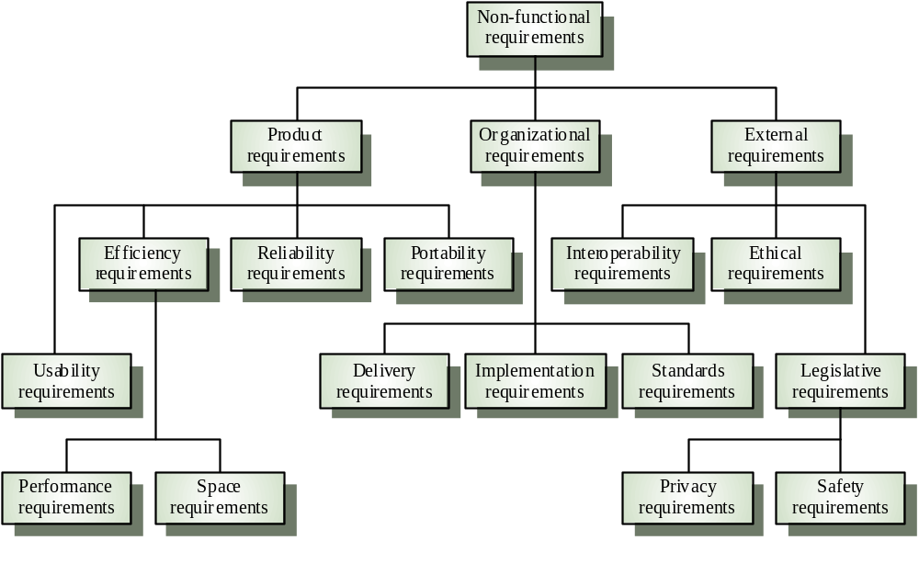
Non-functional classifications

Slide 31
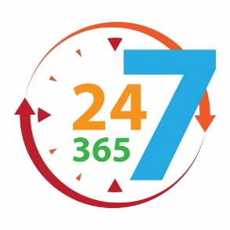
Non-functional requirements
Availability
  Availability is a measure of the planned up time during which the system is actually available for use and fully operational.
  More formally, availability equals the mean time to failure (MTTF) for the system divided by the sum of the MTTF and the mean time to repair the system after a failure is encountered.
  Example: An online banking system must be available 24/7 so customers can transfer money anytime
  MTTF is Mean time to failure
  MTTR is Mean time to Recover

Slide 32
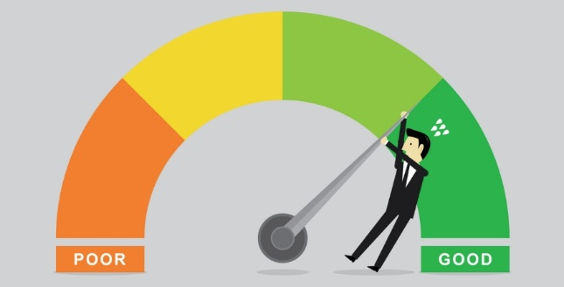
Non-functional requirements
Efficiency
Efficiency is a measure of how well the system utilizes processor capacity, disk space, memory, or communication bandwidth.
If a system consumes too much of the available resources, users will encounter degraded performance, a visible indication of inefficiency.
Example : A search engine should return results in less than 1 second even if millions of records exist

Slide 33
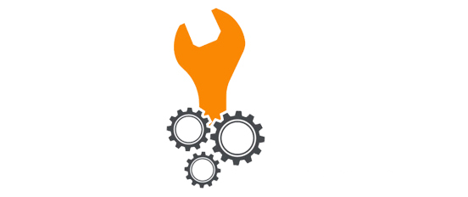
Non-functional requirements
Flexibility
Flexibility measures how easy it is to add new capabilities to the product.
If developers anticipate making many enhancements, they can choose design approaches that maximize the software's flexibility.
Example: An e-commerce platform should allow adding new payment methods (like JazzCash, Easypaisa) without redesigning the whole system.

Slide 34

Non-functional requirements
Interoperability
Interoperability indicates how easily the system can exchange data or services with other systems.
Example: A hospital management system should be able to exchange patient data with a laboratory’s system using standard formats (HL7, XML, APIs).

Slide 35

Non-functional requirements
Reliability
Reliability means the system should perform its intended function correctly and consistently over a specified period of time without failure.
Example: An ATM should always dispense the correct amount when a user withdraws cash.

Slide 36
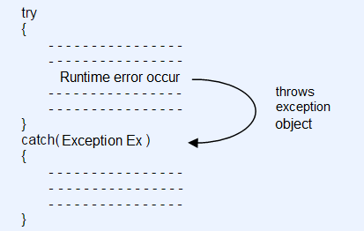
Non-functional requirements
Robustness
Robustness, sometimes called fault tolerance, is the degree to which a system continues to function properly when confronted with invalid inputs, defects in connected software or hardware components, or unexpected operating conditions.
Robust software recovers gracefully from problem situations and is forgiving of user mistakes.
If a user uploads a wrong format file, the system should show an error message instead of crashing.

Slide 37

Non-functional requirements
Usability
Also referred to as ease of use and human engineering, usability addresses the many factors that constitute what users often describe as user-friendliness.

Slide 38
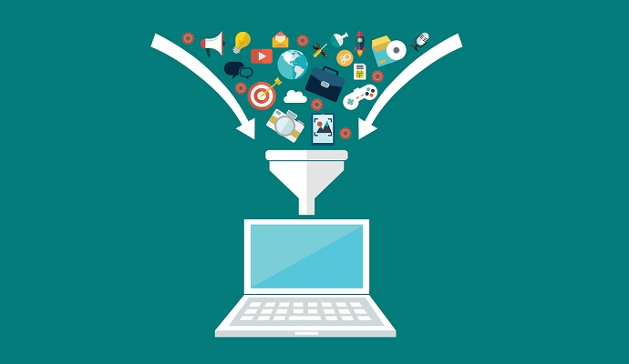
Non-functional requirements
Integrity
No Change in data
Integrity is about ensuring that data and system resources are accurate, consistent, and protected from unauthorized or accidental modification

Slide 39

Maintainability
Maintainability indicates how easy it is to correct a defect or modify the software.
Maintainability depends on how easily the software can be understood, changed, and tested.

Slide 40
Attribute Trade-offs
ANY Trade-offs?

Slide 41


For any query Feel Free to ask

